Slide 1
Vascular Disease in Western New York
Jackie Kim
Notes:
Updated statistics and interesting way to present them
JI before I was here and after I was here
Who I worked with
I was introduced to a wide variety of resources
The information is out there; it’s just a matter of how committed you are to finidin it
Why I did it/ how it fits into JI story
What I did
JI Landscape before and after (before: 3 stats from 2006; after: my slides)
Questions

Slide 2

Causes of Death in the U.S.
#1: Cardiovascular Disease
#2: Tumor
#3: Respiratory Disease
#4: Cerebrovascular Disease
In the U.S., every 40 seconds, one person dies of cardiovascular disease and another suffers a stroke.
Notes:
Causes of Death in the U.S.: CDC – Causes of Death, 2011 preliminary http://www.cdc.gov/nchs/data/nvsr/nvsr61/nvsr61_06.pdf
“In the U.S., every 40 seconds…”: American Heart Association – Heart Disease and Stroke Statistics 2014 http://circ.ahajournals.org/content/129/3/e28.full.pdf+html

Slide 3
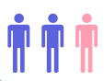
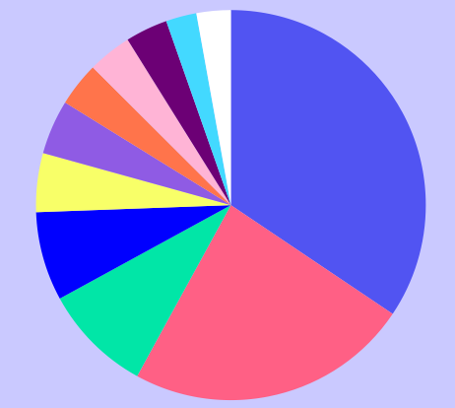
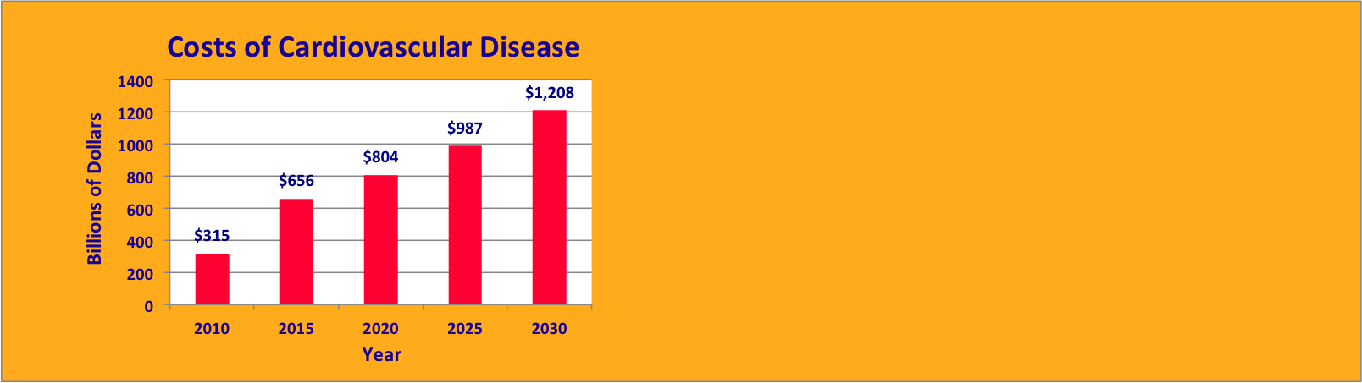
Cardiovascular Disease
Causes of Death in Erie County
By age 60, two in every three people in the U.S. have cardiovascular disease
Cardiovascular disease is responsible for over a third of all deaths in Erie County
Over the next 20 years, the costs of cardiovascular disease in the U.S. are projected to grow by nearly 400%
Notes:
“By age 60, two in every three people…”: AHA – Heart Disease and Stroke Statistics 2014 http://www.heart.org/idc/groups/ahamah-public/@wcm/@sop/@smd/documents/downloadable/ucm_459072.pdf
Causes of Death in Erie County: CDC – County-Specific Data Portal http://wonder.cdc.gov/
Costs of Cardiovascular Disease: AHA – Heart Disease and Stroke Statistics 2014 http://www.heart.org/idc/groups/ahamah-public/@wcm/@sop/@smd/documents/downloadable/ucm_459072.pdf

Slide 4
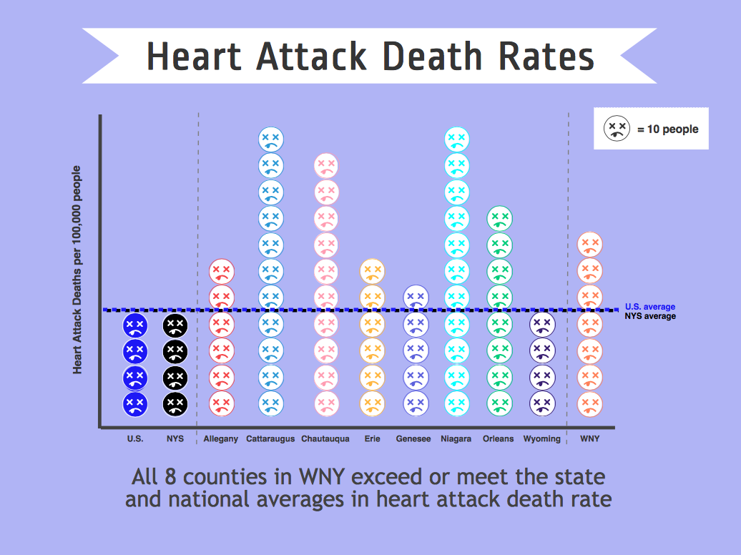
Notes:
Heart Attack Death Rates: CDC – County-Specific Data Portal http://wonder.cdc.gov/

Slide 5
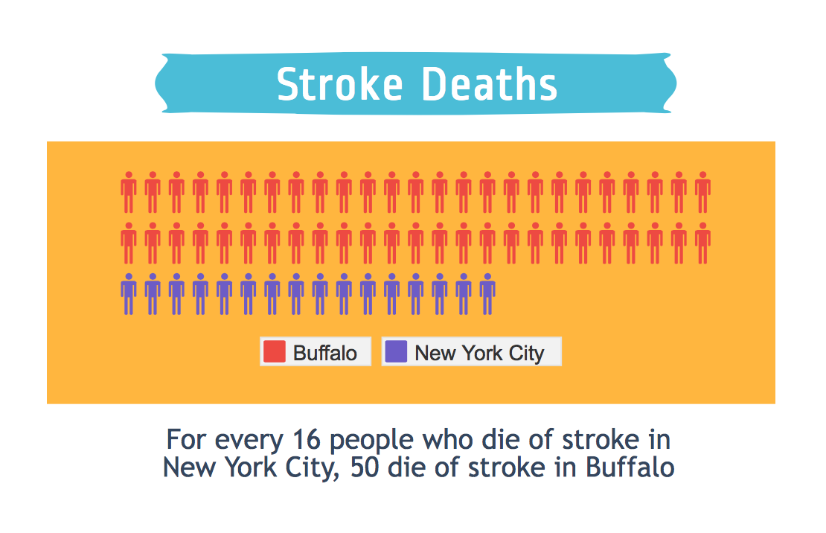
Notes:
Stroke Deaths: CDC – County-Specific Data Portal http://wonder.cdc.gov/

Slide 6
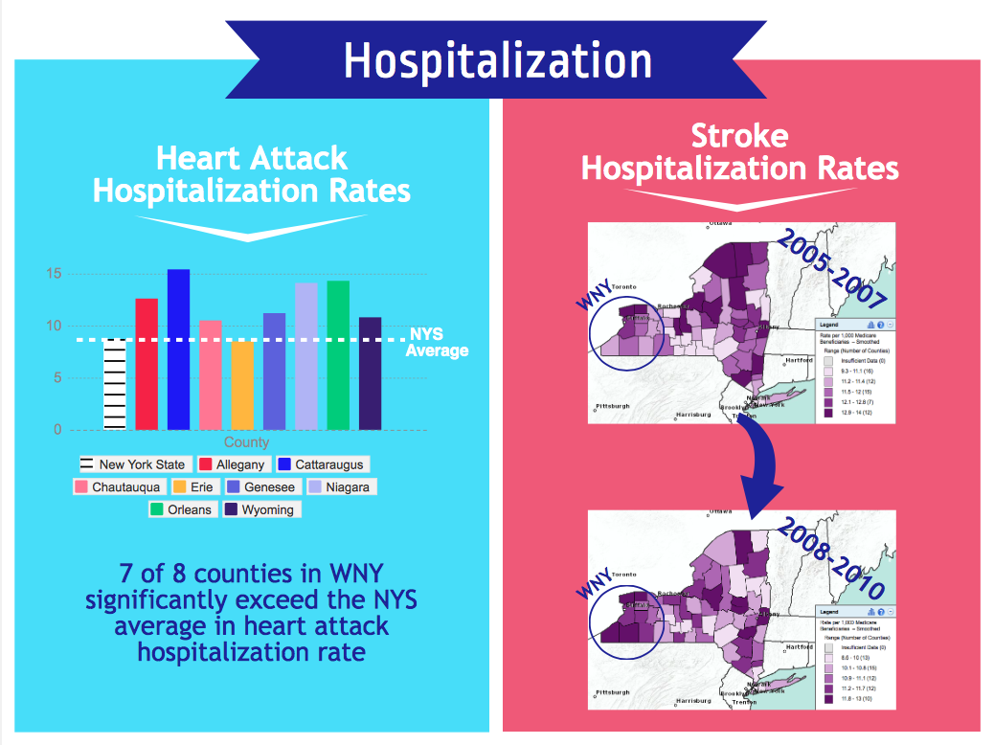
Notes:
Heart Attack Hospitalization Rates: CDC – Interactive Atlas of Heart Disease and Stroke Maps http://nccd.cdc.gov/DHDSPAtlas/viewer.aspx?state=NY
Stroke Hospitalization Rates: CDC – Interactive Atlas of Heart Disease and Stroke Maps http://nccd.cdc.gov/DHDSPAtlas/viewer.aspx?extent=-9298433.812412424,-7580966.766045585,4803255.04932001,5758618.884029376&mode=county&state=NY&thematicType=health&filterIds=6,3,5,7,10,1&filterOptions=1,1,1,1,1,1&themeSubClassId=20&overlays=Streets:0,1;cdc_base:0,1,2,3,4,5,6,15;

Slide 7
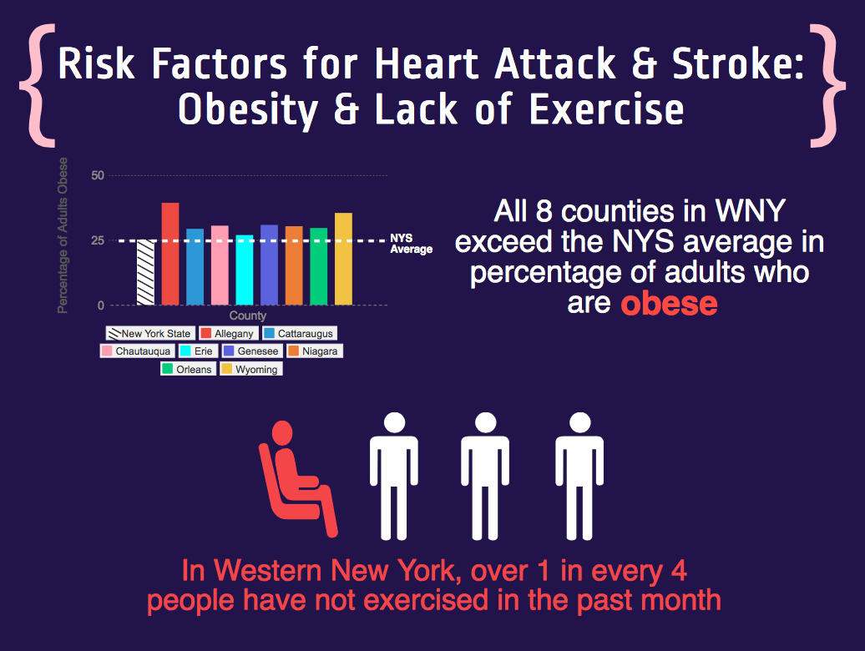
Notes:
Percentage of Adults Obese: National Center for Health Statistics – Health Indicators Warehouse http://www.healthindicators.gov/Indicators/Selection
“In Western New York, over 1 in every 4…”: New York – County Health Rankings http://www.countyhealthrankings.org/app/new-york/2014/overview

Slide 8
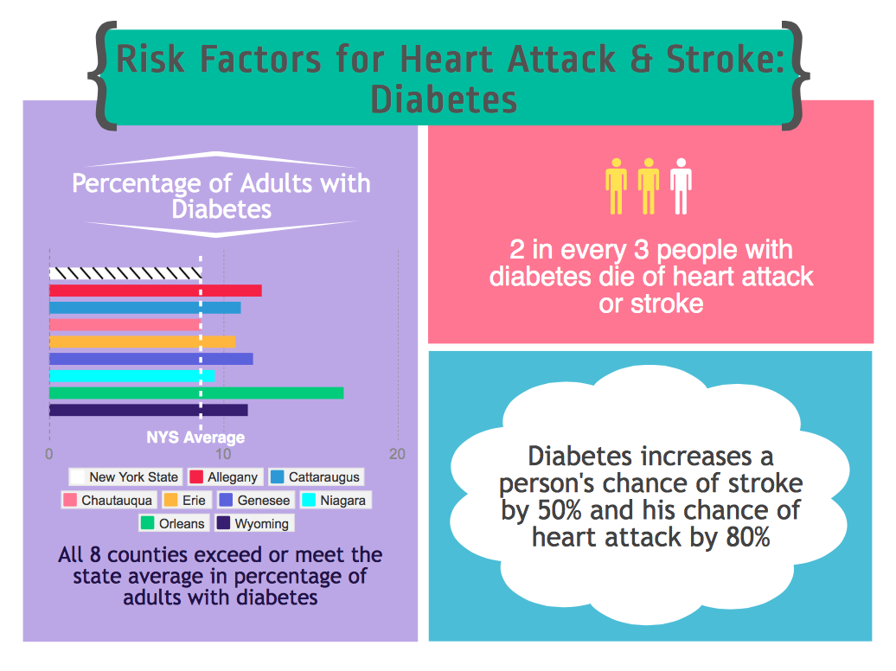
Notes:
Percentage of Adults with Diabetes: National Center for Health Statistics – Health Indicators Warehouse http://www.healthindicators.gov/Indicators/Selection
“2 in every 3 people with diabetes…”: National Diabetes Education Program – CVD & Diabetes http://www.ndep.nih.gov/media/CVD_FactSheet.pdf
“Diabetes increases a person’s chance…”: CDC – National Diabetes Statistics Report 2014

Slide 9
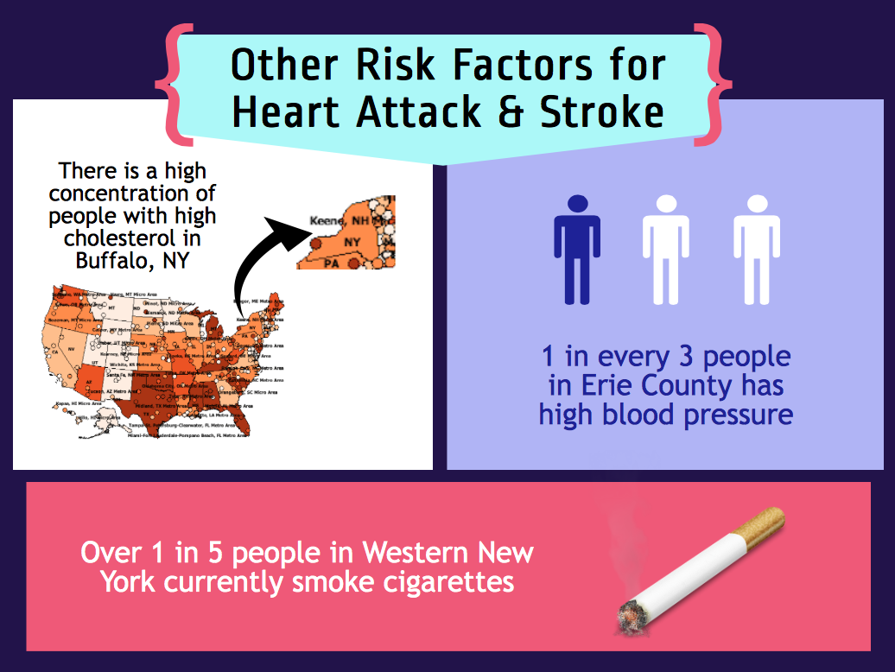
Notes:
High Cholesterol Map: Behavioral Risk Factor Surveillance System – “Adults who have had their blood cholesterol checked and have been told it was high” http://apps.nccd.cdc.gov/gisbrfss/select_question.aspx
“1 in every 3 people in Erie County…”: National Center for Health Statistics – Health Indicators Warehouse http://www.healthindicators.gov/Indicators/Selection
“Over 1 in 5 people in Western New York…”: National Center for Health Statistics – Health Indicators Warehouse http://www.healthindicators.gov/Indicators/Selection

Slide 10
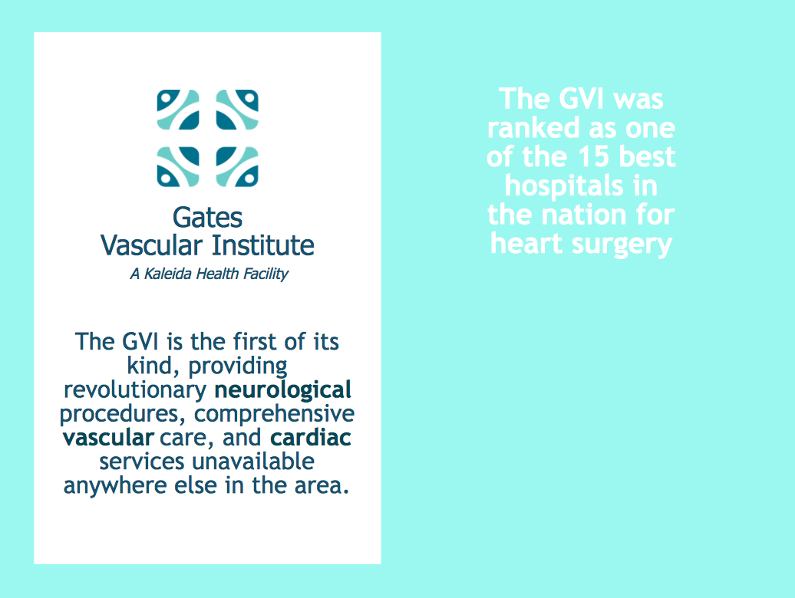
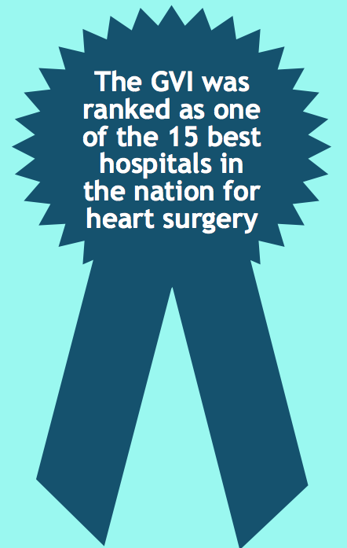
Notes:
“The GVI is the first of its kind…”: Kaleida Health – Gates Vascular Institute Homepage http://www.kaleidahealth.org/gvi/
“The GVI was ranked as one of…”: Consumer Reports – Top Scoring Hospitals for Heart Surgery http://www.consumerreports.org/cro/magazine/2014/08/top-scoring-hospitals-for-heart-surgery/index.htm

Slide 11
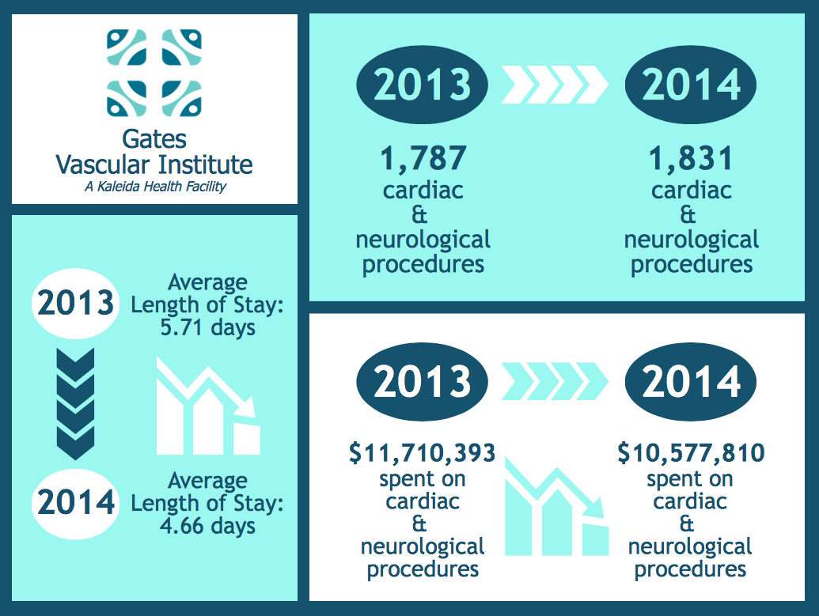
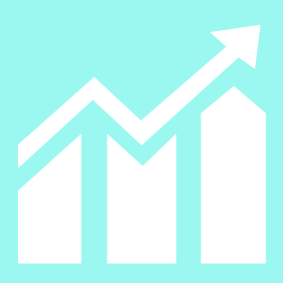
Notes:
All Data: GVI patient records (extracted and calculated by Michael Whyte)

Slide 12
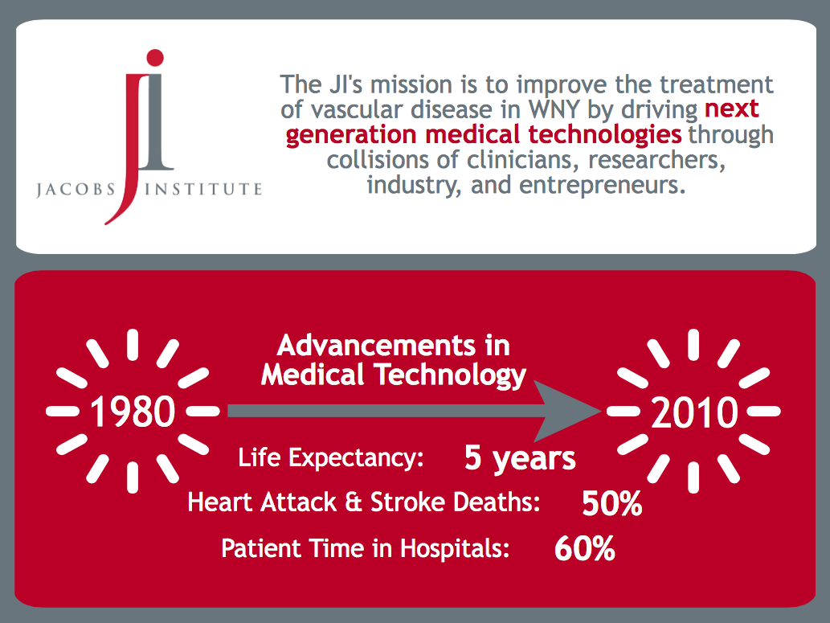
Notes:
“The JI’s mission is to improve the treatment…”: Jacobs Institute Website – Mission & Vision http://www.jacobsinstitute.com/index.php/mission-vision
Advancements in Medical Technology: Mass Device – “Biomet CEO: Medtech helps curb healthcare costs” http://www.massdevice.com/news/biomet-ceo-medtech-helps-curb-healthcare-costs-massdevicecom-call

